Slide 2
Learning Objectives
LO 1.1 Distinguish between physical and historical geology and describe the connections between people and geology.
LO 1.2 Summarize early and modern views on how change occurs on Earth and relate them to the prevailing ideas about the age of Earth.
LO 1.3 Discuss the nature of scientific inquiry, including the construction of hypotheses and the development of theories.
LO 1.4 List and describe Earth’s four major spheres. Define system and explain why Earth is considered to be a system.

Slide 3
Learning Objectives (cont.)
LO 1.5 Outline the stages in the formation of our solar system.
LO 1.6 Describe Earth’s internal structure.
LO 1.7 Sketch, label, and explain the rock cycle.
LO 1.8 List and describe the major features of the continents and ocean basins.

Slide 4
1.1 Geology: The Science of Earth
Geology is the science that pursues an understanding of planet Earth.
Physical geology examines the materials composing Earth and seeks to understand the many processes that operate beneath and upon its surface.
Historical geology seeks an understanding of the origin of Earth and its development through time.

Slide 5
1.1 Geology: The Science of Earth (cont.)
Geology, people, and the environment
There are many important relationships between people and the natural environment.
Some of the problems and issues addressed by geology involve natural hazards, resources, world population growth, and environmental issues.

Slide 6
1.1 Geology: The Science of Earth (cont.)
Some historical notes about geology
The nature of Earth has been a focus of study for centuries.
Catastrophism
Uniformitarianism and the birth of modern geology

Slide 7
1.2 The Development of Geology
Geologists are now able to assign fairly accurate dates to events in Earth history
Relative dating and the geologic time scale
Relative dating means that dates are placed in their proper sequence or order without knowing their age in years.
The magnitude of geologic time
Involves vast times: Millions or billions of years
An appreciation for the magnitude of geologic time is important because many processes are gradual.

Slide 8
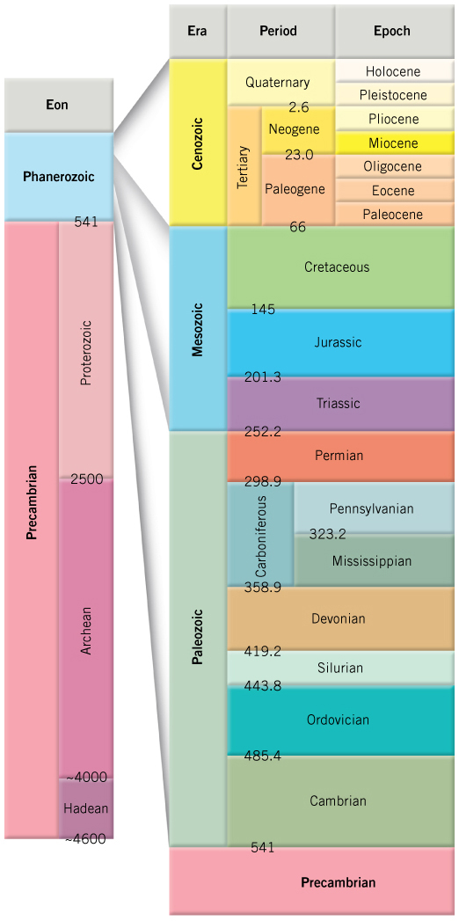
The Geologic Time Scale

Slide 9
1.3 The Nature of Scientific Inquiry
Science assumes the natural world is consistent and predictable.
The goal of science is to discover patterns in nature and use the knowledge to make predictions.
Scientists collect facts through observation and measurements.

Slide 10
1.3 The Nature of Scientific Inquiry (cont.)
How or why things happen are explained using a
Hypothesis: A tentative (or untested) explanation
Theory: A well-tested and widely accepted view that the scientific community agrees, best explains certain observable facts.

Slide 11
1.3 The Nature of Scientific Inquiry (cont.)
Scientific method
Scientific method involves gathering facts through observations and formulation of hypotheses and theories.
There is no fixed path that scientists follow that leads to scientific knowledge.

Slide 12
1.4 Earth as a System
Earth is a planet that is small and self-contained.
Earth’s four spheres
Hydrosphere
Atmosphere
Biosphere
Solid Earth

Slide 13
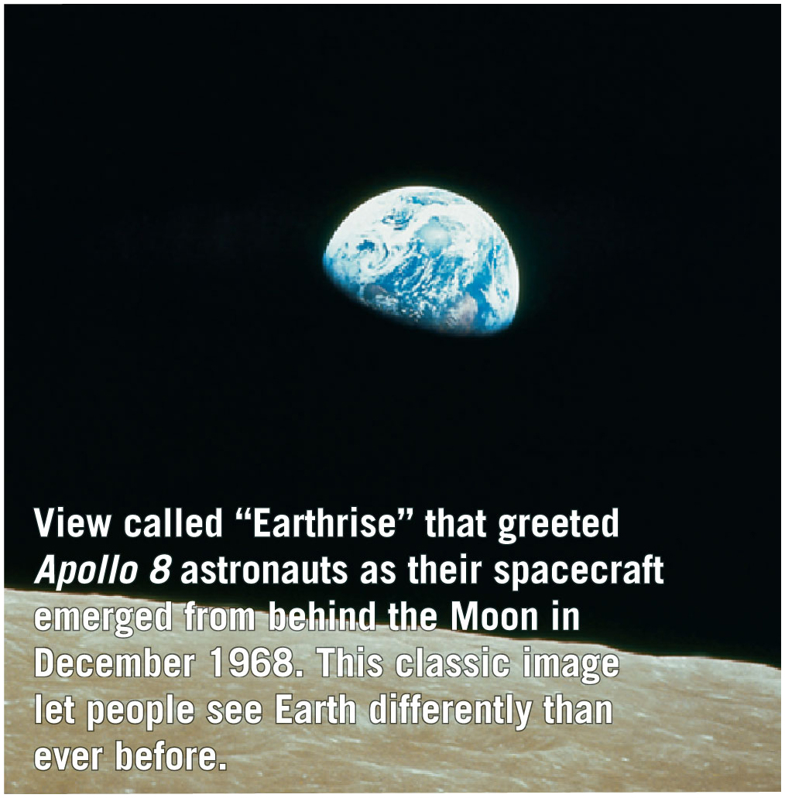
A View of Earth from the Moon
Video

Slide 14
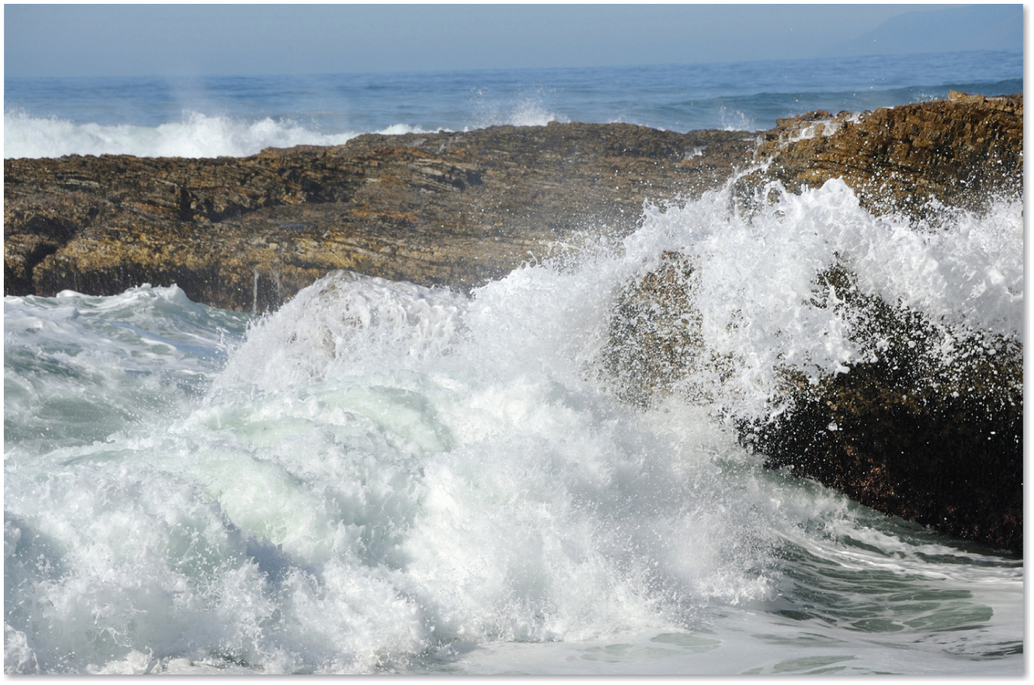
The Intersection of Three Spheres: Atmosphere, Hydrosphere, and Geosphere

Slide 15
1.4 Earth as a System (cont.)
Earth is a dynamic planet with many interacting parts or spheres
Parts of the Earth system are linked
It is characterized by processes that
vary on spatial scales from fractions of a millimeter to thousands of kilometers
have time scales that range from milliseconds to billions of years

Slide 16
1.4 Earth as a System (cont.)
The Earth system is powered by the Sun, which drives external processes
In the atmosphere
In the hydrosphere
At Earth’s surface

Slide 17
1.4 Earth as a System (cont.)
The Earth system is also powered from Earth’s interior.
Heat remaining from the Earth’s formation and heat that is continuously generated by radioactive decay powers the internal processes that produce volcanoes, earthquakes, and mountains.

Slide 18
1.5 Origin and Early Evolution of Earth
The universe began with the Big Bang 13.7 billion years ago.
Earth and the other planets formed at essentially the same time out of the same material as the Sun.
The Nebular Theory proposes that the bodies of our solar system evolved from an enormous rotating cloud called the solar nebula.

Slide 19
1.5 Origin and Early Evolution of Earth (cont.)
Nebular Theory
The solar nebula consisted of hydrogen and helium in addition to microscopic dust grains.
A disturbance caused the solar nebula to slowly collapse and rotate.
The solar nebula assumed a flat, disk shape with the protosun (pre-Sun) at the center.
Inner planets began to form from metallic and rocky substances.
Larger outer planets began forming from fragments of ices (H₂O, CO₂, and others).

Slide 20
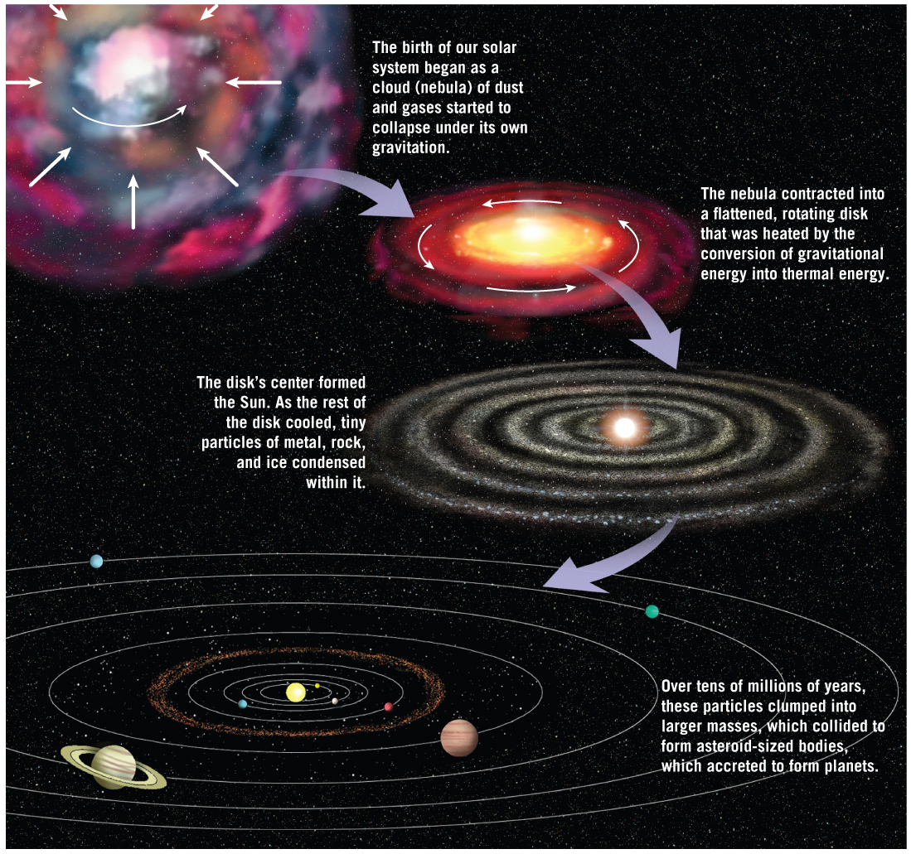
The Nebular Theory
Tutorial

Slide 21
1.5 Origin and Early Evolution of Earth (cont.)
Formation of Earth’s layered structure
Metals sank to the center.
Molten rock rose to produce a primitive crust.
Chemical differentiation established the three basic divisions of Earth’s interior (core, mantle, crust).
A primitive atmosphere evolved from volcanic gases.
The earliest primitive crust was lost to erosion and geologic processes.

Slide 22
1.6 Earth’s Internal Structure
Earth’s internal layers can be defined by
Chemical composition
Physical properties
Layers defined by composition
Crust
Mantle
Core

Slide 23
1.6 Earth’s Internal Structure (cont.)
Four main layers of Earth are based on physical properties and hence mechanical strength
Lithosphere
Asthenosphere
Outer core
Inner core

Slide 24
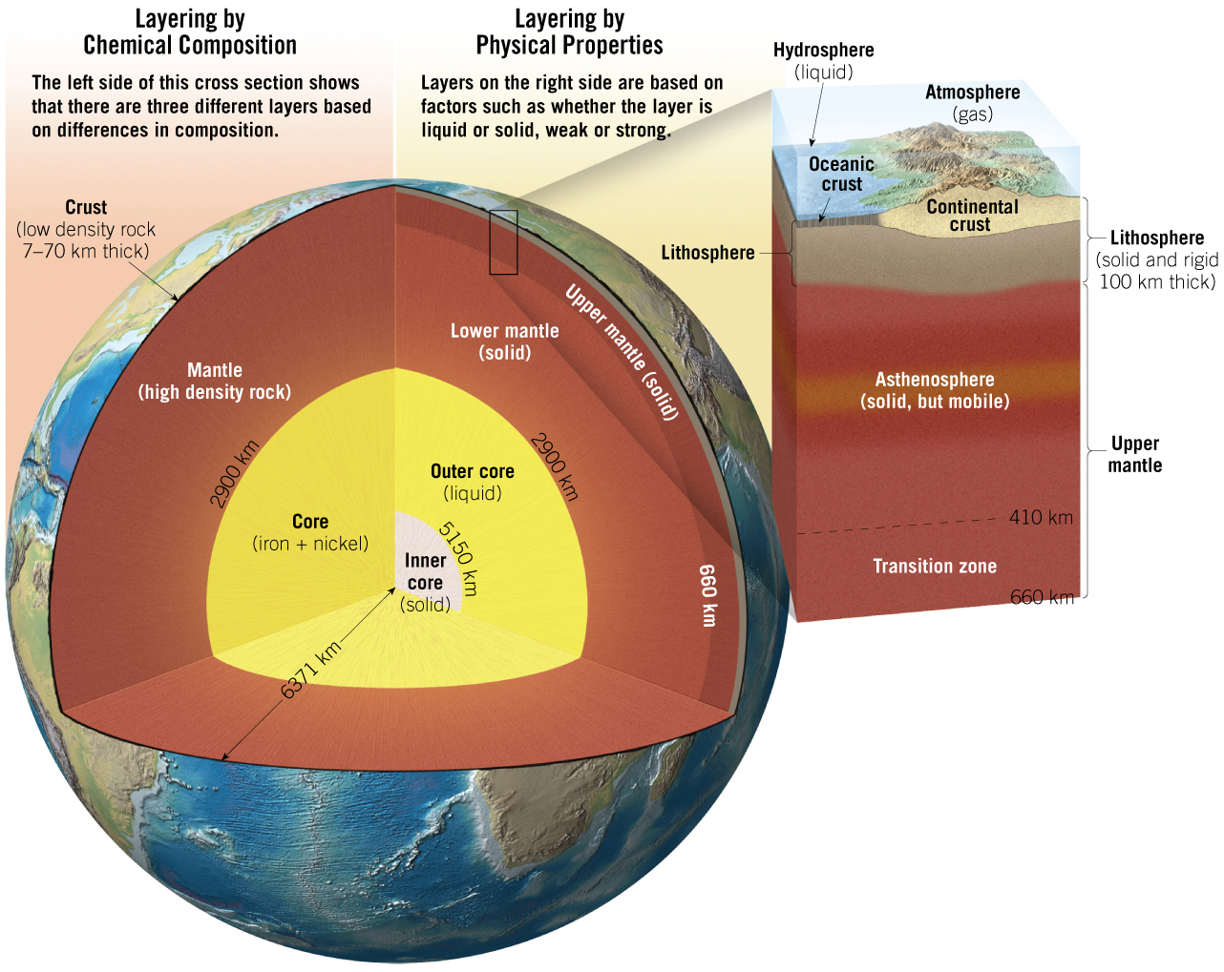
1.6 Earth’s Internal Structure (cont.)
Tutorial

Slide 25
1.7 Rocks and the Rock Cycle
Illustrates the interrelationships among different parts of the Earth system through various processes.

Slide 26
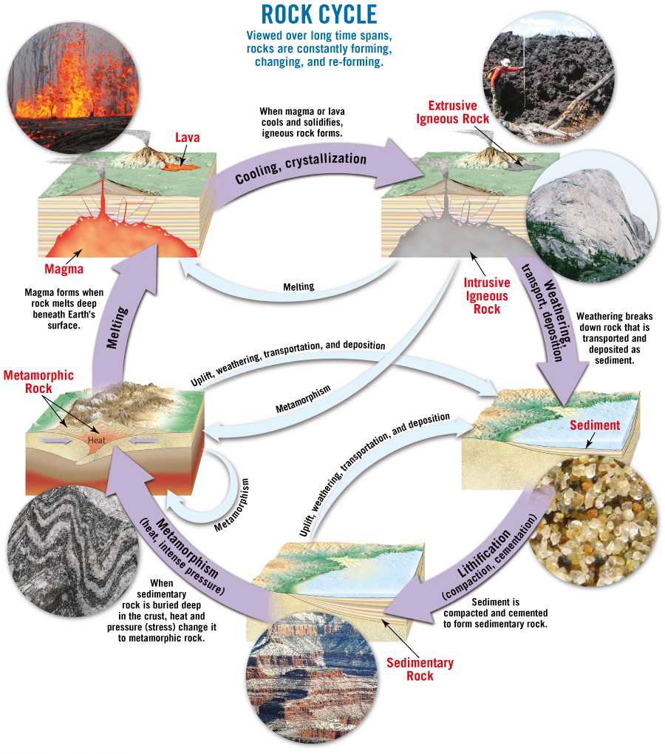
The Rock Cycle
Tutorial

Slide 27
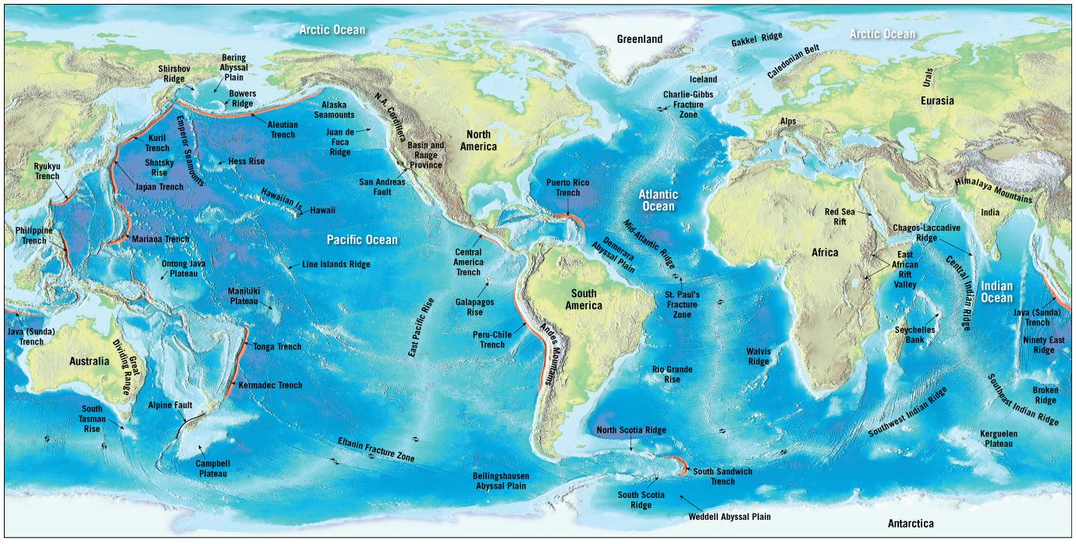
1.8 The Face of Earth
Earth’s surface is divided.

Slide 28
1.8 The Face of Earth (cont.)
Ocean basins
Continental margins
Includes the continental shelf, continental slope, and the continental rise
Deep-ocean basins
Abyssal plains
Oceanic trenches
Seamounts
Oceanic ridge system
Most prominent topographic feature on Earth
Composed of igneous rock that has been fractured and uplifted

Slide 29
1.8 The Face of Earth (cont.)
Earth’s surface
Continents
Oceans
Continents
Mountain belts
Most prominent feature of continents
The stable interior
Shields and stable platforms

Slide 30
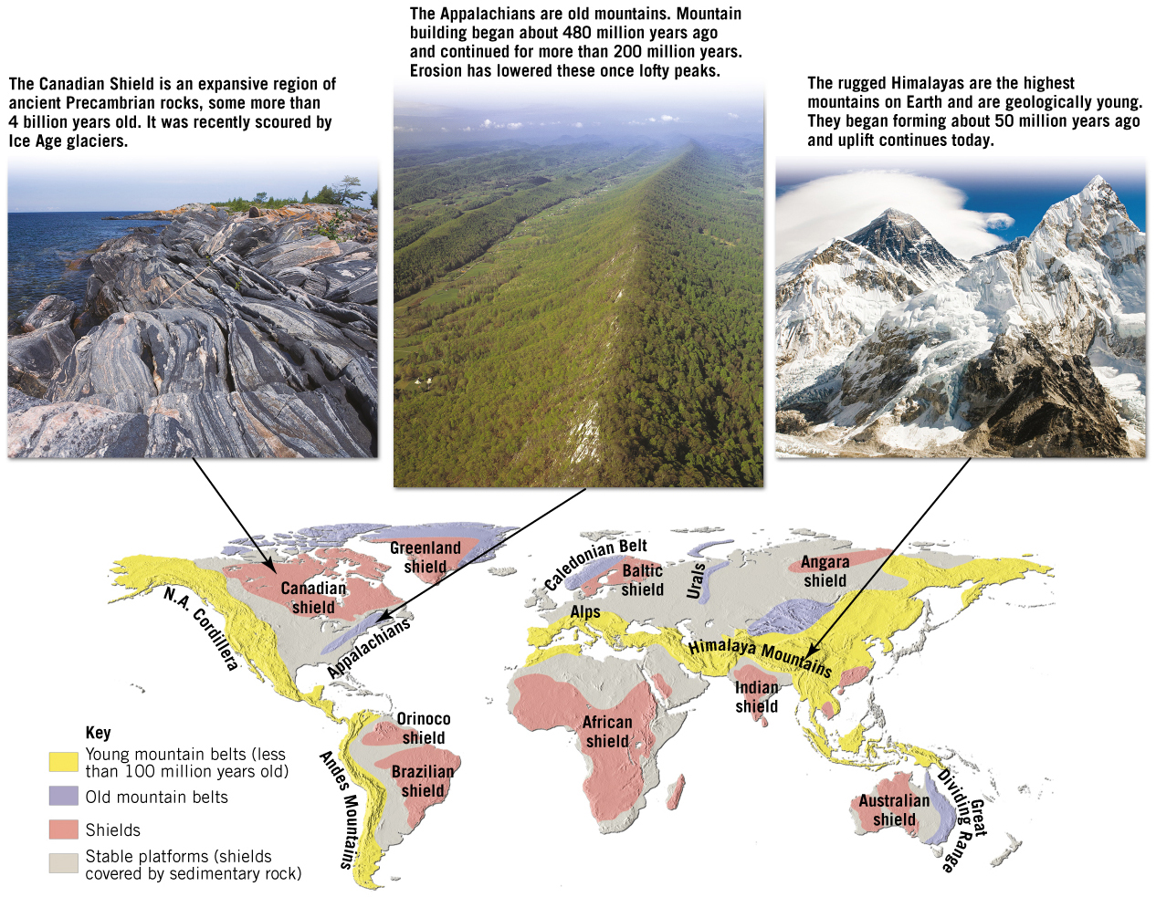
Earth’s Mountain Belts, Stable Platforms, and Shields
Tutorial

